Slide 1
Woodland Public Schools
Facilities and Safety Report
December 2018 – January 2019

Slide 2
FACILITIES REPORT
Buckeye Trees
Twelve new Celebration maples trees were planted over the holiday shutdown period on Buckeye Street. The balance of the Pin Oak trees (4) will be dropped over the next few weeks. After the trees are dropped, the last 4 Maples will be planted in their place.
School Realignment
Minor modifications to the schools will be needed in order to support the smaller (or larger) students. Most of this work will occur in the restrooms at the Intermediate School. Numerous bathroom fixtures will have to be lowered to accommodate the smaller students; this includes sinks, urinals and bathroom accessories such as mirrors, towel dispensers etc. I also asked ESD Safety to take a look at the play systems for potential problems with the new age students. This was completed last week.
Facilities will also be prepping another portable interior at the Primary School. Over the last 18 months, the exterior work was completed on all the portables in the District (9 excluding new WIS, Head Start and COOP Preschool portables). Roofs, siding, ramps, framing repairs and paint were completed at that time. Interior work was only completed on portable 11/12 at WPS. We will renovate interiors as needed to support additional classroom spaces.

Slide 3
FACILITIES REPORT
Yale Chlorination
Construction will begin next week, on the new building that will contain the chlorination equipment, including metering pump, chlorine storage tank, flowmeter and associated electrical controls. Olson Engineering has completed the design and submitted plans to Department of Health. Once the permit is approved, work can start on these systems. I expect this work to be complete by the end of April.
Job Safety Analysis Program
A review of the Job Safety Analysis (JSA) program has identified some opportunities for improvement. The complete District employee list was bounced against the completed forms on file. Many of the forms are missing, and some are not completed correctly. At the beginning of this school year, the JSA form was added to the new employees check-in procedure. This action will fix most of the issues, and I will work with the Admin Team to ensure the program is completed with the current employees.

Slide 4
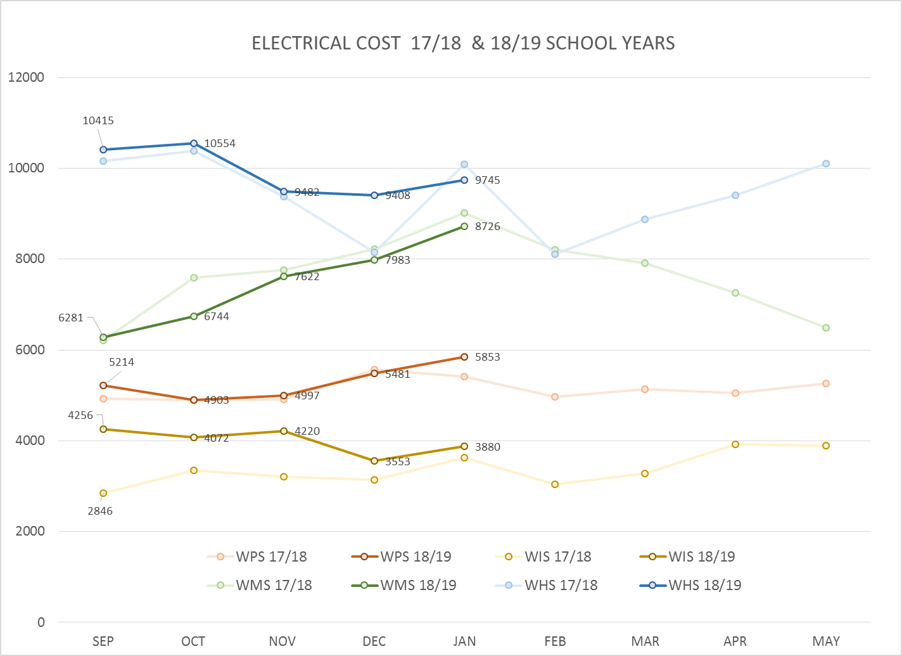
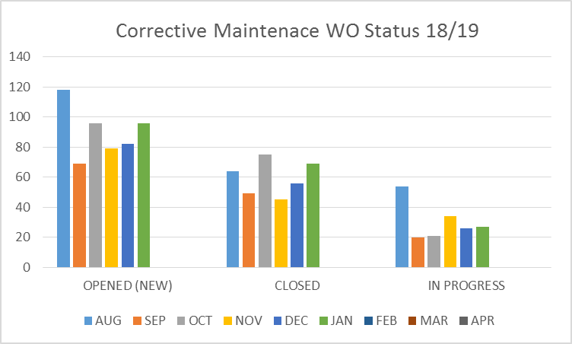
FACILITY CHARTS – POWER COST AND WORK ORDER STATUS

Slide 5
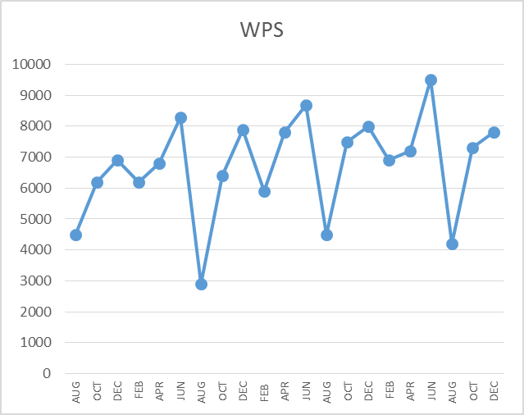
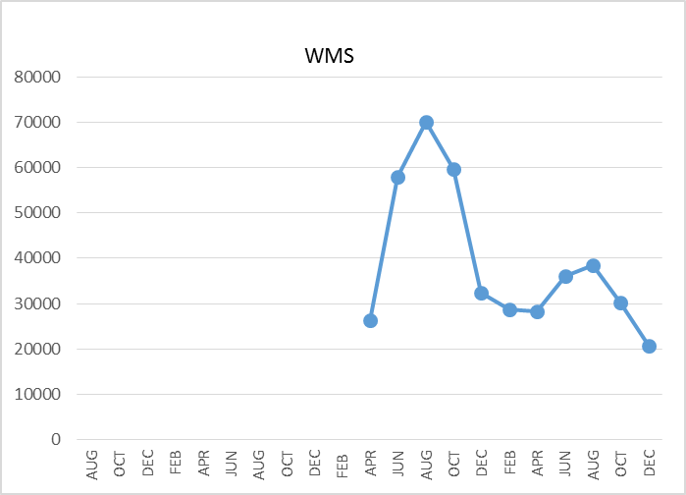
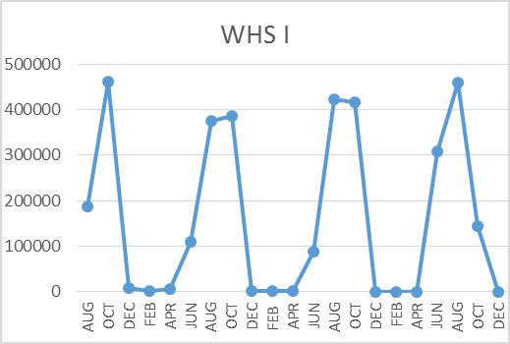
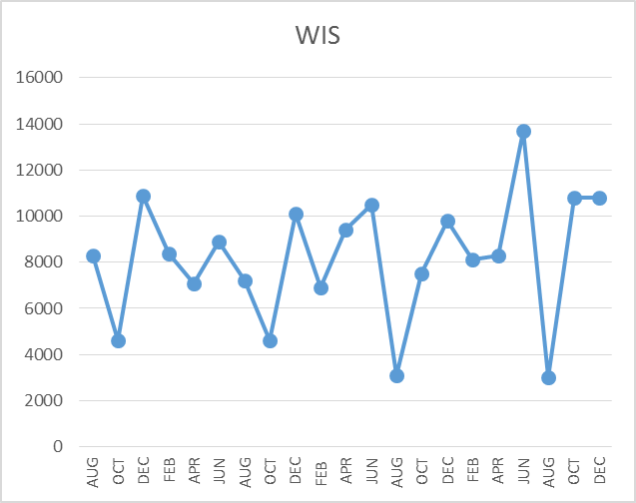
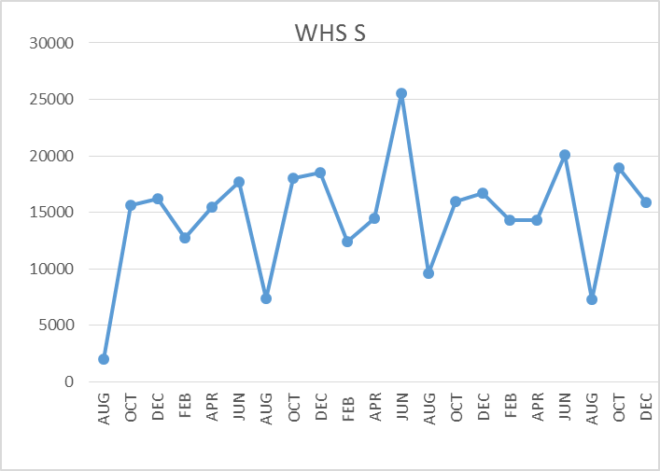
FACILITY CHARTS – WATER USAGE WHS, WIS, WMS, WPS
Note
Water charts are updated every two
months. Next update to these charts
in March 2019.
The WMS chart has been reconfigured to include the following 7 meters: 755 Park high and low flow, BO and Team High, PIT house, bus barn, athletic field and DO. All of these meters are totaled on the WMS graph, but each data point is recorded separately to aid in identifying leaks.

Slide 6
SAFETY CHARTS
Accidents for the Month (January)
There were 5 accidents/incidents for the month; 2 staff and 3 students.
Staff Accidents/Incidents
Bus driver slipped and fell in crosswalk (not school property, not school related).
WIS student bit employee on arm during de-escalation.
Student Accidents/Injuries
WPS – Student was hit in head with swing, laceration to head.
WHS – Student fractured foot during basket ball.
Quest – Student tripped on mat bruised cheek and lost tooth.

Slide 7
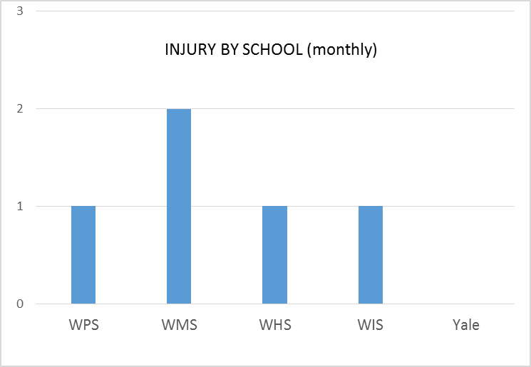
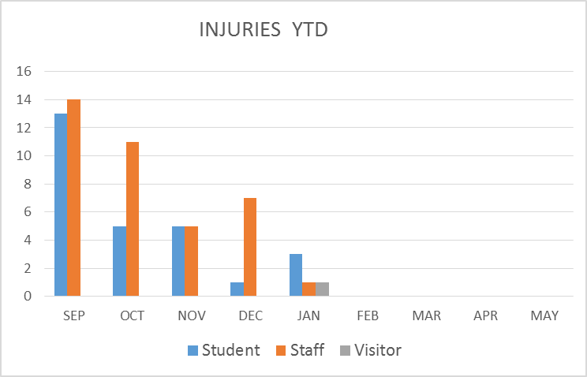
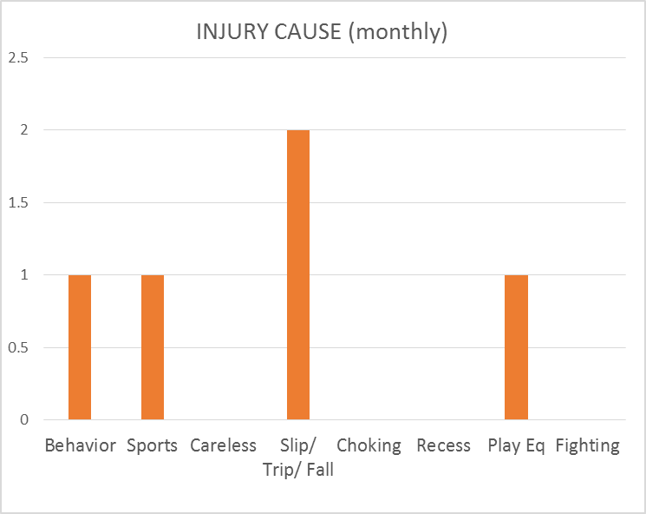
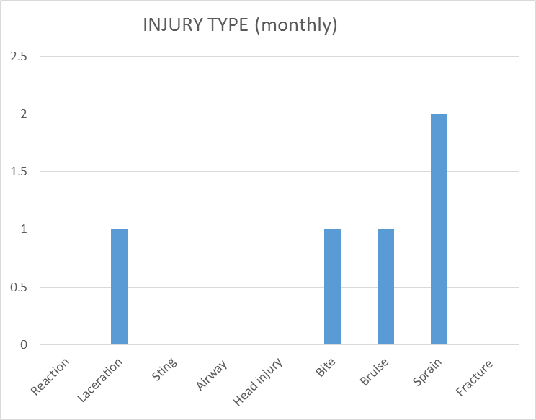
SAFETY CHARTS

